Slide 1
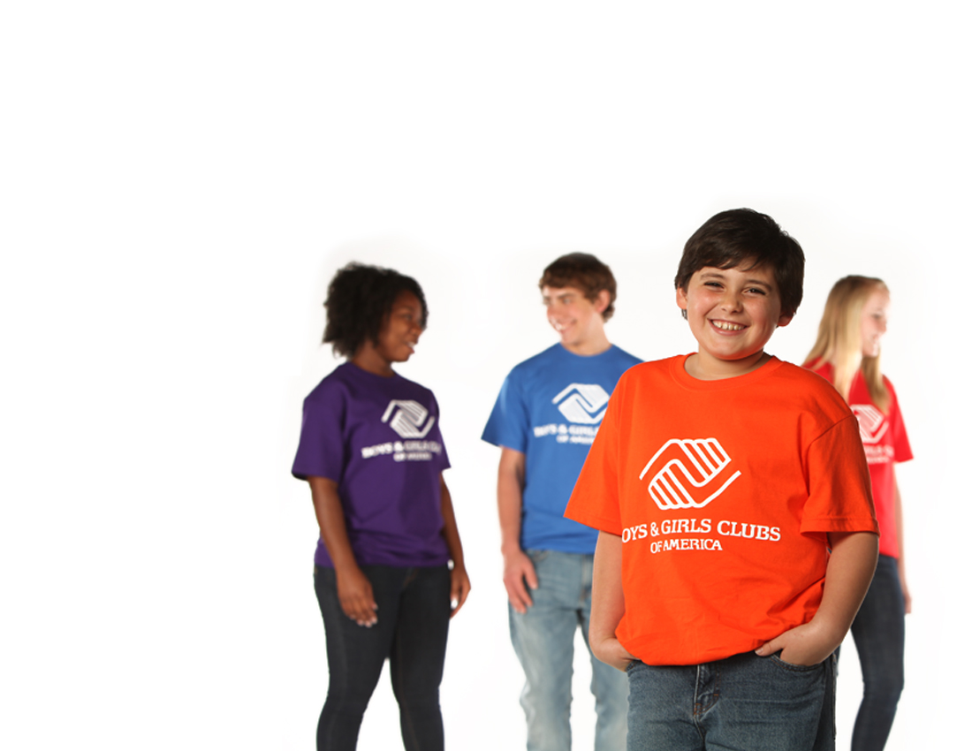
Mentoring at the
Lubbock Boys & Girls Clubs

Slide 2
Mentor Orientation
Our goal at the Clubs is to meet the needs of our at-risk youth by being matched with a highly motivated mentor that can be a friend and get involved in their young lives. We ask that you spend time with them at the Club, encouraging them and serving as a positive role model through homework help, sports, robotics, computers and many other activities. They will look to you for support and guidance. Through mentoring programs, Clubs can help fill important gaps in their members’ lives.
A volunteer mentor’s personal attention and guidance can truly open new doors of hope and opportunity for LBGC youth.
The Boys & Girls Club mission is to inspire and enable all young people to realize their full potential as productive, responsible and caring citizens.

Slide 3
Mentoring with Impact
We are focusing on our members that are considered at risk according to the risk factors below:
Truancy
Discipline issues
Peer problems
Poor school performance
Family stress
No positive role model
Neighborhood with high crime activity.
Clubs strive to improve a member’s anti-social behavior (bullying, fighting, arguing, etc.) and social competence (ability to get along with other people) and academic success.

Slide 4
Goals and Expectations
We need mentors to meet with their mentees, determine what their academic/social goals need to be for the semester or year and work with the staff and mentee to meet these goals.
We need mentors to help their mentee to explore barriers and help them problem solve to remove those barriers.
Please help the mentee keep track of and care about their performance and success.
You can share personal examples and come back week after week and help them celebrate their accomplishment at the end.
We need you to document information about each contact with your mentee. Forms will be available. Staff will be
available to assist you.

Slide 5
A Mentor is a……
Nurturer
Coach
Cheerleader
Confidant
Friend
Supporter
Role model

Slide 6
Youth who have mentors:
Experience fewer absences at school
Are less likely to abuse drugs
Demonstrate more positive attitudes
Display greater confidence in their schoolwork
Show improved academic performance

Slide 7
It Just Takes One
One opportunity can make a lasting difference in the life of a child.
One dream can give a sense of purpose for a lifetime.
One voice can relay wisdom that resonates for generations.
One Boys & Girls Club can give hope to an entire neighborhood.
One person can fulfill the dream of a brighter tomorrow for more children in out community. Be the difference.

Slide 8
The Lubbock Boys & Girls Clubs ask that mentors:
*Make sure all paperwork is completed.
*Follow dress code (no low cut shirts, no short shorts)
*Cell phones and headphones are not allowed during your time.
*Sign in when you come in the Club and sign out when you leave.
*No smoking anywhere near the Clubs.
*Please do not give or accept gifts from the members.
*Please see the Unit Director if you have any concerns.

Slide 9
